Slide 1
Developing with Azure Functions
Notes:
This module examines developing with Azure Functions to execute asynchronous server-side processing jobs and to provide a quick and efficient way to create a custom Web API accessible to Single Page Applications (SPAs) and SharePoint Framework Web Parts. Students will learn the fundamentals of creating, testing and debugging Azure Functions in the Azure Portal. The module also explains the options for configuring security for an Azure Function App and for supporting Cross-Origin Resource Sharing (CORS) to ensure your Azure Functions can be called from your client-side application code. The module teaches students how to create and publish Azure Function Apps using Visual Studio 2017 and C# as well as how to call Azure Functions from the client-side TypeScript code written in a SPA or a SharePoint Framework Web Part.

Slide 2
Agenda
Introduction to Developing with Azure Functions
Creating and Testing Azure Functions in the Azure Portal
Using Azure Functions to Create a Custom Web API
Configuring Security and Cross-Origin Resource Sharing
Calling Azure Functions from SPFX Web Parts
Developing Azure Function in Visual Studio using C#

Slide 3
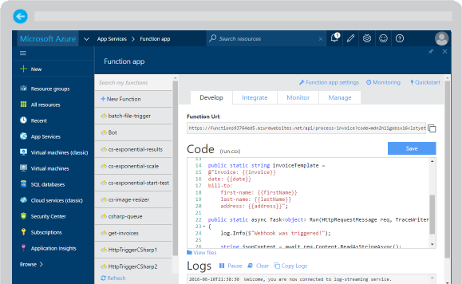
Azure Functions
Create a “serverless” event-driven experience that extends the existing Azure App Service platform by building “nanoservices” that can scale based on demand
Notes:
Azure Functions are part of the Azure Web + Mobile suite of App Services and are designed to enable the creation of small pieces of meaningful, reusable methods, easily shared across services. These serverless, event-driven methods are often referred to as “nanoservices” due to their small size. Although an Azure Function can contain quite a bit of code, they are typically designed to serve a single purpose, and respond to events in connected services.

Slide 4

Dual abstraction
Serverless compute abstracts away the compute
Bindings abstract away services you interact with
Other Services
Business Logic
Serverless PaaS

Slide 5
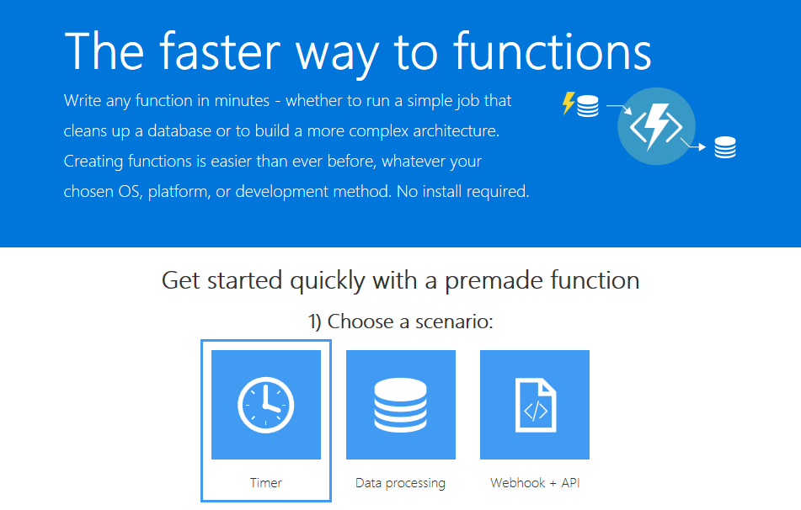
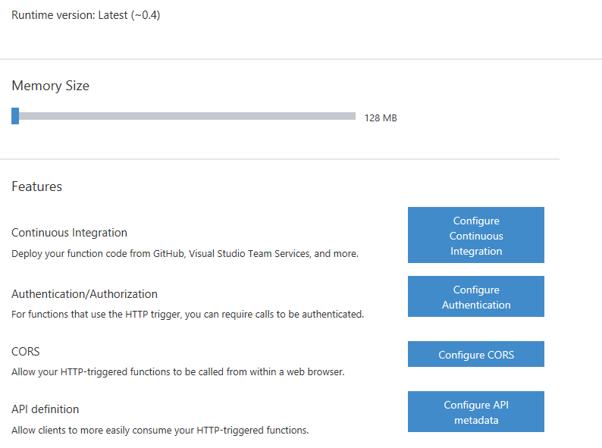
Supported Languages and Tools
Create functions in JavaScript, C#, Python, and PHP, as well as scripting options such as Bash, Batch, and PowerShell, that can be triggered by virtually any event in Azure, 3rd party services, or on premise systems
Notes:
Azure Functions can be created in most common development and scripting languages, and can be “triggered” by events in other Azure App Services, such as Web, Mobile, Logic, and API apps. Azure Functions can also be exposed via HTTP URL schemes for easy integration into legacy systems.

Slide 6

Common Scenarios
Timer-based processing
Azure service event processing
SaaS event processing
Serverless web application architectures
Serverless mobile backends
Real-time stream processing
Real-time bot messaging
Your App or Service
Office 365
Office Graph
Azure Storage
Legacy Systems
Web Services
Other Functions
Notes:
Azure Functions are “event-driven” meaning they run based on associated and configure events, or “triggers”. For example an Azure Function could be triggered by a simple timer, such as running a process once every 24-hours, or triggered by an event in a document management system, such as when a new document is uploaded to a SharePoint library. Azure Functions can also respond to Azure-specific events, such as an image added to a Storage Blob or a notification arriving in a Message Queue.

Slide 7
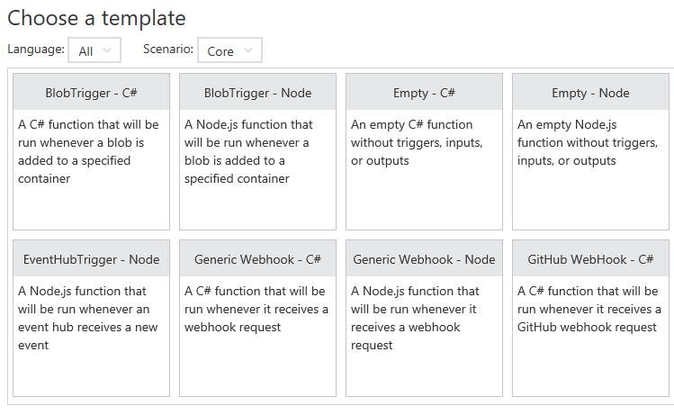
Function App Templates
Function App templates
BlobTrigger
EventHubTrigger
Generic webhook
GitHub webhook
HTTPTrigger
QueueTrigger
ServiceBusQueueTrigger
ServiceBusTopicTrigger
TimerTrigger
Blank & Experimental
Notes:
Although Azure Functions can be created from scratch”, the Azure Portal exposes a large number of ever-growing templates to help get developers started. These templates are typically designed with specific triggers in mind, such as a Blob Storage event, or a GitHub webhook event. Templates can easily form the basis for robust function creation, and are really designed just to get a developer started.

Slide 8
Timer Function Apps
Run at explicitly specified intervals
e.g. executes once every 5 minutes
Configured using CRON expressions ( "0 */5 * * * *" )
Can send information to other systems, but typically don’t “return” information, only write to logs
Great for redundant cleanup and data management
Great for checking state of services
Can be combined with other functions
Notes:
Timer Functions are exactly what they sound like: Functions triggered by a specific time event. Timer Functions are perfect for clean up and maintenance processes and can easily be combined with other functions for more robust scenarios. Timer Functions us CRON expressions to configure schedules. It’s a good idea to get familiar with CRON syntax, but in the meantime there are a number of tools online to help you build CRON expressions.

Slide 9
Data Processing Function Apps
Run when triggered by a data event, such as an item being added to a queue or container
Typically have in and out parameters
Great for responding to CRUD events
Great for performing CRUD events
Great for moving content
Access data across services
Notes:
Data Processing Functions are triggered by activity in a datastore, such as a table, queue, or container. Data Processing Functions also typically have both “in” and “out” parameters, meaning they can accept an object as a parameter, and then process information and then return another object from within the function. This is not the same as a “return” value, as most Azure Functions either return void, or an HTTP response such as “created”, “accepted”, or “OK”.

Slide 10
Webhook & API Function Apps
Triggered by events in other services
GitHub
Team Foundation Services
Office 365
OneDrive
Microsoft PowerApps
Takes in a request and sends back a response
Often mimic Web API and legacy web services flows
Typically need CORS settings managed
Best for exposing functionality to other apps and services
Great for building Logic Apps
Notes:
Webhook and API Functions are designed to easily integrate with 3rd party systems, like GitHub, Office 365, and especially Microsoft PowerApps. Since Webhook and API Functions are often exposed to external or legacy systems, they typically need CORS settings managed in order to “allow” external resources to “see” and execute the function. Most Azure Logic Apps leverage Webhook and API Functions directly.

Slide 11
Anatomy of a Function
“Run” file that containing the function code
“Function” file containing service & trigger bindings & parameters
“Project” file containing project assembly and NuGet packages
App Service settings, such as connection strings and API keys
code
Executable code
Function configuration
.NET Core and Project references
Notes:
An Azure Function is really a group of a few files that work in harmony. All actual function logic resides in a “Run” file written in a language of choice. A “Project” file is similar to a project file in other technologies such as .NET Core or Universal Windows Platform and contains “secondary” assembly references such as NuGet packages. Finally a “Function” file contains information about triggers and parameters, such as locations of Storage Queue connection strings and whether the parameter is design as an “in”, “out” or “bi-directional”. Optionally, additional configuration is also found in the Function App Settings such as an API Key or database connection string.

Slide 12
Function Bindings
Bindings used to create connections to and from function
Many bindings can be “bi-directional” as well.
Type | Service | Trigger | Input | Output
Schedule | Azure Functions | ✔
HTTP (REST or webhook) | Azure Functions | ✔ |  | ✔*
Blob Storage | Azure Storage | ✔ | ✔ | ✔
Events | Azure Event Hubs | ✔ |  | ✔
Queues | Azure Storage | ✔ |  | ✔
Tables | Azure Storage |  | ✔ | ✔
Tables | Azure Mobile Apps |  | ✔ | ✔
No-SQL DB | Azure DocumentDB |  | ✔ | ✔
Push Notifications | Azure Notification Hubs |  |  | ✔
Notes:
Without bindings, an Azure Function would just be a “disconnected” algorithm without any way to serve a purpose. Bindings server to connect functions and output to other services. Some of the most common binding types and features are listed in the table, however variations and adaptations can and do exist.

Slide 13
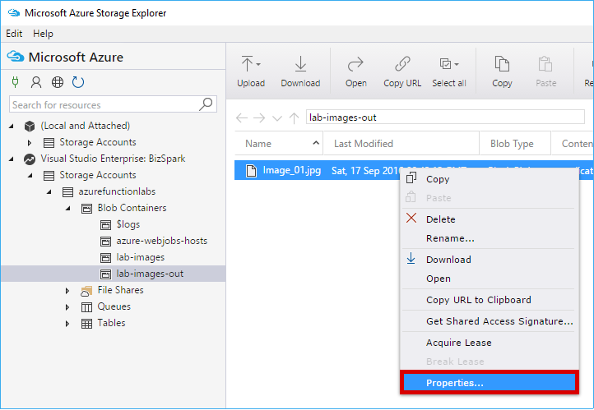
Testing Functions
Command-line tools
3rd party products such as Postman and Swagger
Direct web calls via cURL
Nested functions
Microsoft Azure Storage Explorer
Visual Studio Cloud Explorer
Notes:
Many Azure Functions are exposed via an actual URL that can be called directly from a web client or browser. When an Azure Function is not exposed via a URL its common practice to call the function from another dunction, such as a Timer-based Function for testing purposes only. Since Azure Functions can be nested, testing scenarios can be quite varied. For managing and testing Azure Functions that integrate with Storage Containers, Microsoft provides the Microsoft Azure Storage Explorer, as well as the Visual Studio Cloud Explorer. The Logs console in the Azure Function Designer is also a great way to view and trace function processing.

Slide 14
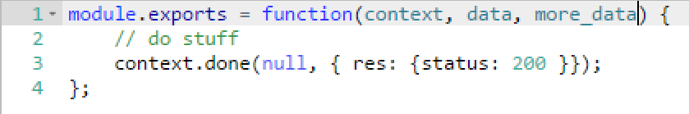
Functions programming concepts
Trigger
Input
Code
Output

Slide 15







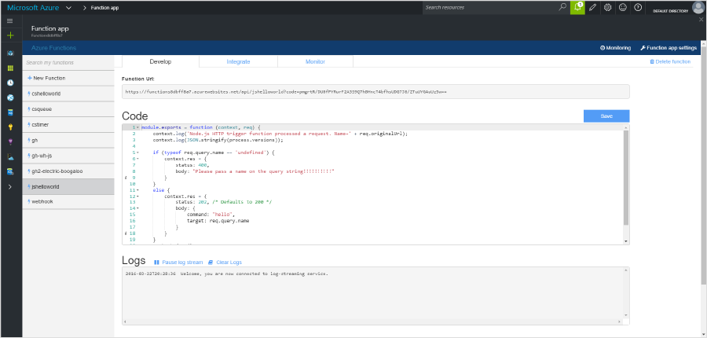
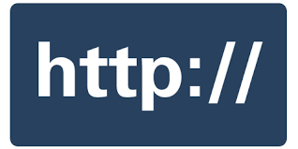




Azure Function Development Process
1) Trigger
2) Input Binding
3) Develop
4) Execute
5) Output Binding
Web
Hooks
App Services
Hosting Plans
Azure Services
Azure Services
Azure Services
7) Develop Locally
6) Monitor and Improve
Notes:
This is the whole (top level) Dev Ops story where Dev build wounderful apps, using CI they mange their code, builds, and releases. Connecting to a repository, they can deploy to Azure Websites, build in the cloud, deploy to a slot to test and validate, swap into production, deployed across the globe as needed, monitor and get feedback, on which devs can make updates. Rinse and repeat

